Slide 1
Numerical Solutions of the Incompressible Navier Stokes Equations
Shourya Mukherjee, Dustin Maguire, Kunal Pathak

Slide 2
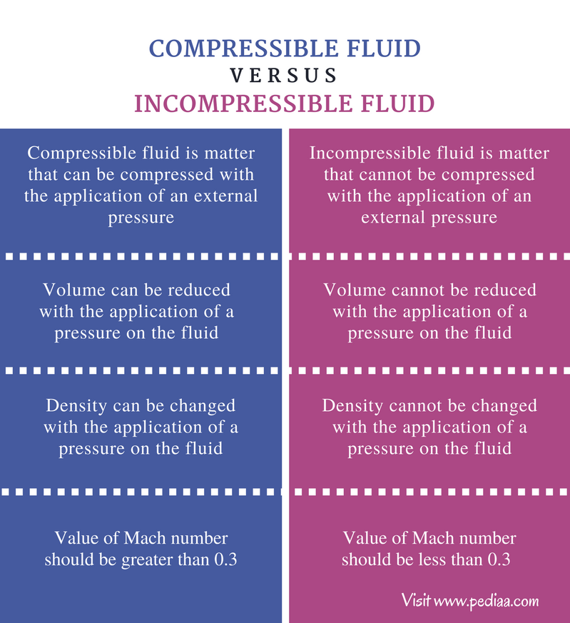
Motivation for Studying Incompressible Fluids
Drug Delivery Optimization
Precision in targeted delivery
Applications to hemodynamics
Efficient medication dispersion
Aerospace modeling and design

Slide 3
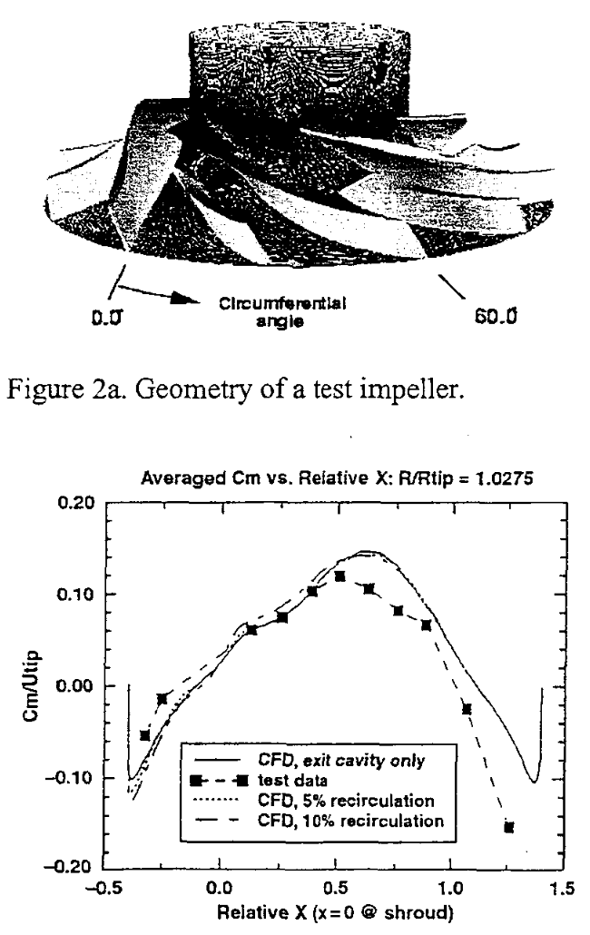
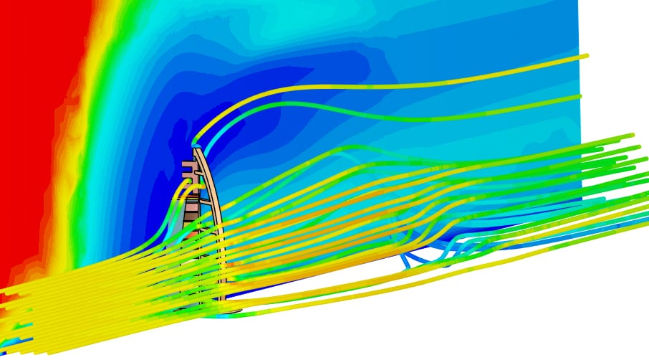
Drug Delivery Optimization
Incompressible fluid simulations assist in
Ensuring effective dispersion of medications within the body.
Facilitate advancements in drug delivery methods for
Personalized medicine
Targeted therapies
https://ntrs.nasa.gov/api/citations/20040084569/downloads/20040084569.pdf
https://www.simscale.com/docs/analysis-types/incompressible-fluid-flow-analysis/
Notes:
Efficient Medication Dispersion

Slide 4
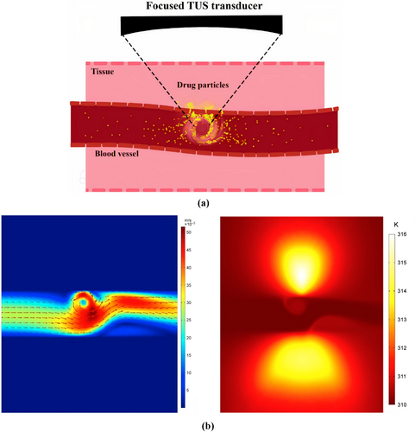
Efficient Medication Dispersion
Incompressible fluid simulations assist in
Developing drug carriers for effective tumor penetration.
Addressing challenges in drug distribution modeling obstacles related to
Heterogeneous blood supply
Irregular vascular structures.
Understanding the blood-brain barrier for precise drug delivery.
https://wires.onlinelibrary.wiley.com/doi/full/10.1002/wnan.1913

Slide 5
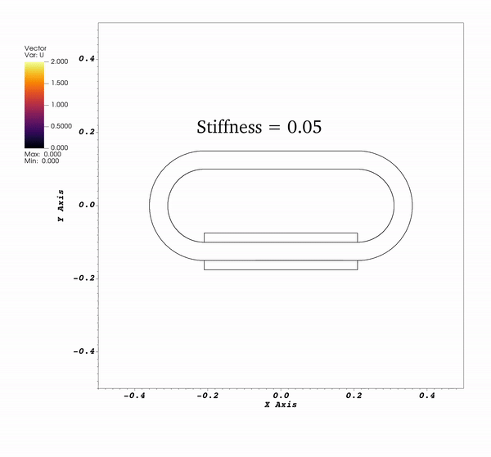


Applications to Hemodynamics
In certain organisms, blood can be modeled as an incompressible Newtonian fluid.
Shear stress plays a mechanical role in the development of the heart structures.
Fluid dynamics simulations allow us to understand causes of congenital heart defects in utero.
Notes:
Simulates valveless heart contraction. In early stages of embryonic development, the human heart can be modelled as a linear heart tube. This is a plot of velocity over time

Slide 6
Theory and Numerical Approach

Slide 7
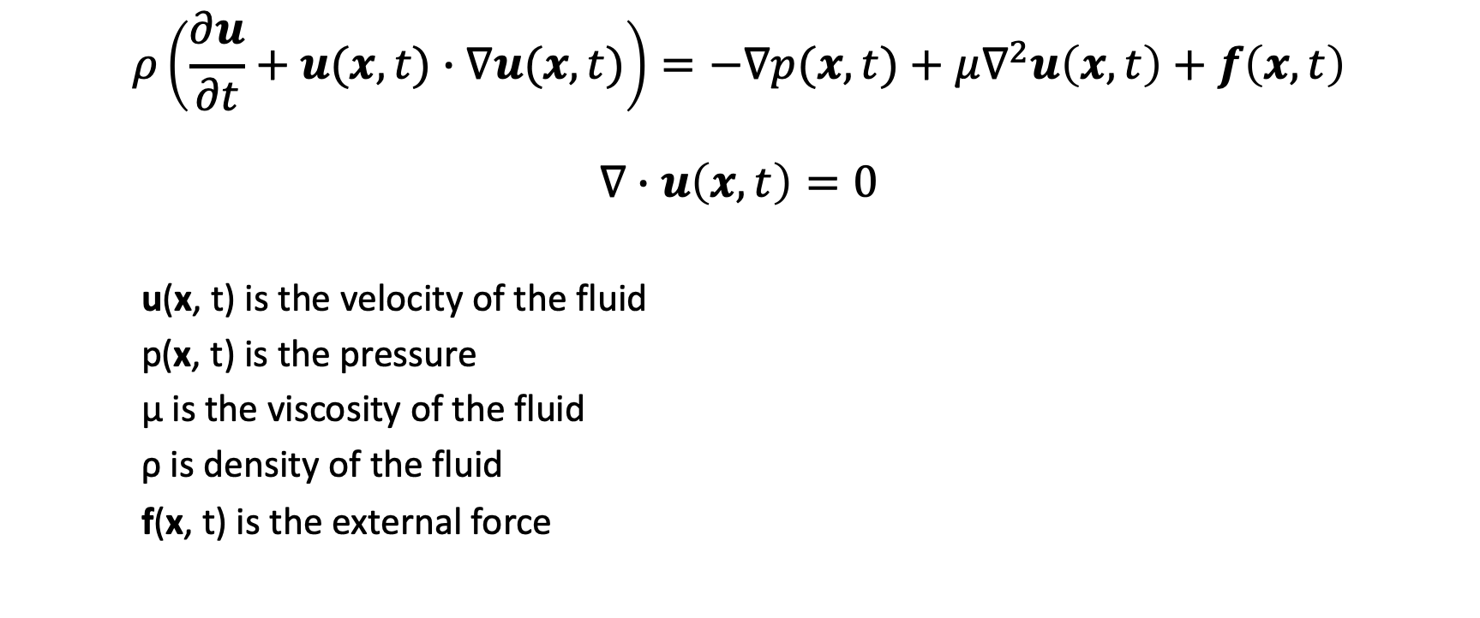
Equations of Motion (Newtonian Fluid)

Slide 8




Numerical Approach
Initialize the fluid domain and boundary.
Discretize the Navier Stokes equations using finite difference operators.
Reformulate the discretized equation to remove coupling.

Slide 9
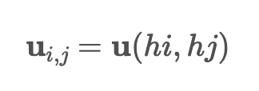
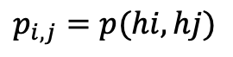
Numerical Approach
Initialize the fluid domain and boundary.
Initialize the fluid domain as a Cartesian grid of length L x L.
Velocity and pressure is initialized for each grid point.
Discretize the Navier Stokes equations using finite difference operators.
Reformulate the discretized equation to remove coupling.

Slide 10
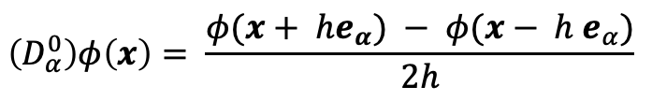
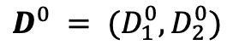
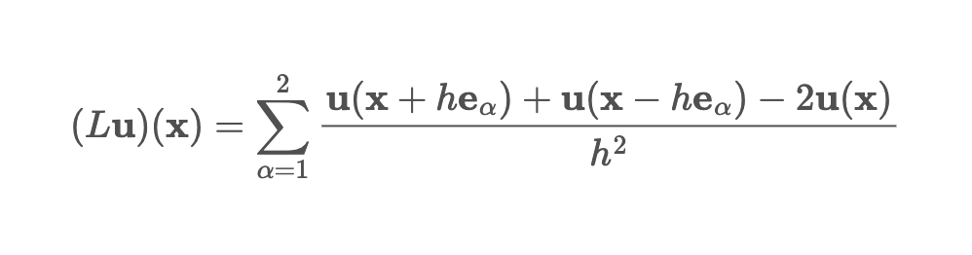
Numerical Approach
Initialize the fluid domain and boundary.
Define finite difference operators for divergence and Laplacian.
Discretize the Navier Stokes equations using finite difference operators.
Reformulate the discretized equation to remove coupling.
*We use periodic boundary conditions on the entire boundary

Slide 11
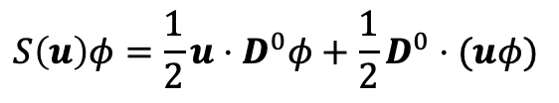
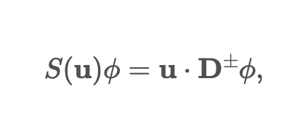
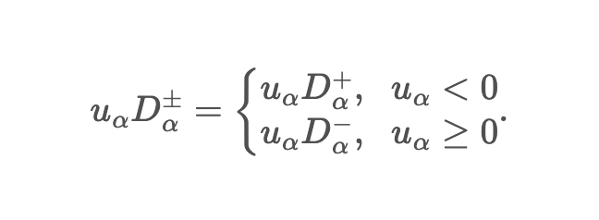
Numerical Approach
Initialize the fluid domain and boundary.
For the convective term, we can choose a central finite difference discretization
Discretize the Navier Stokes equations using finite difference operators.
or we can choose an upwind discretization
Reformulate the discretized equation to remove coupling.

Slide 12
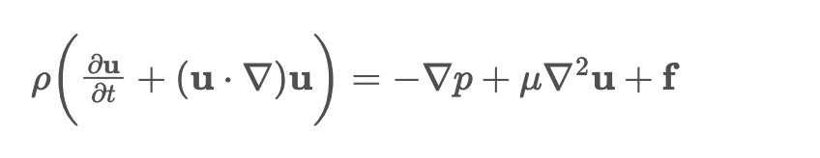
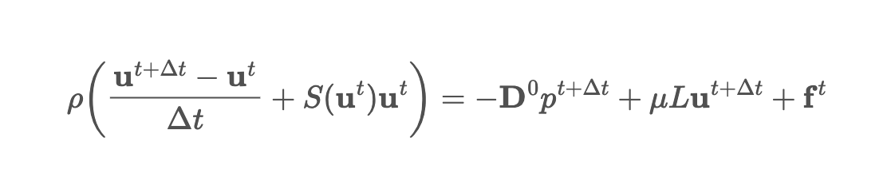
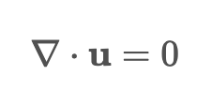

Numerical Approach
Original Equations
Initialize the fluid domain and boundary. Discretize time domain.
Discretized momentum equation
Discretize the Navier Stokes equations using finite difference operators.
Discretized continuity equation
Reformulate the discretized equation to remove coupling.

Slide 13
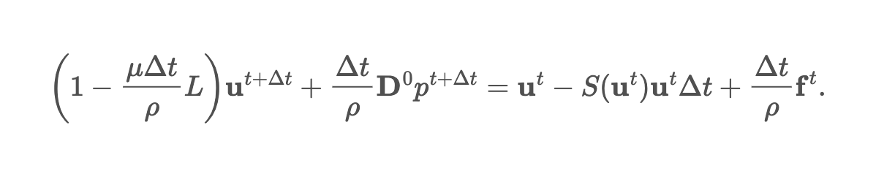
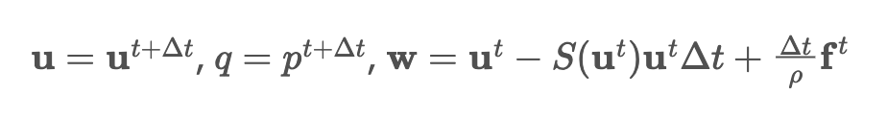
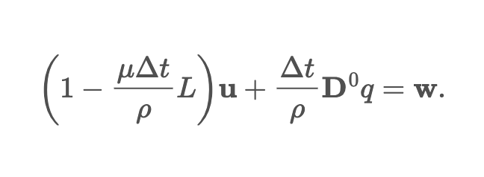
Numerical Approach
Initialize the fluid domain and boundary. Discretize time domain.
Discretize the Navier Stokes equations using finite difference operators.
Make variable substitutions
Reformulate the discretized equation to remove coupling.

Slide 14
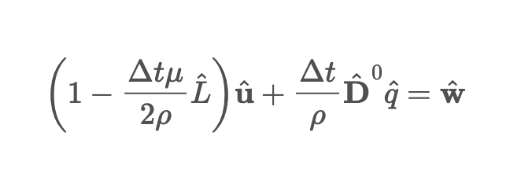
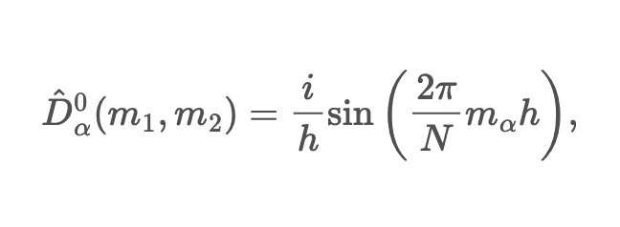
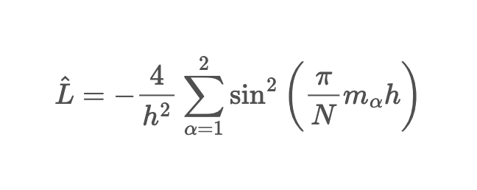
Numerical Approach
Initialize the fluid domain and boundary. Discretize time domain.
Fourier transformed Navier Stokes equations
Discretize the Navier Stokes equations using finite difference operators.
where the Fourier transformed operators are
Reformulate the discretized equation to remove coupling.

Slide 15


Numerical Approach
Initialize the fluid domain and boundary. Discretize time domain.
Update rule
Discretize the Navier Stokes equations using finite difference operators.
No coupling
The scheme supports half stepping.
Reformulate the discretized equation to remove coupling.

Slide 16
Results

Slide 17
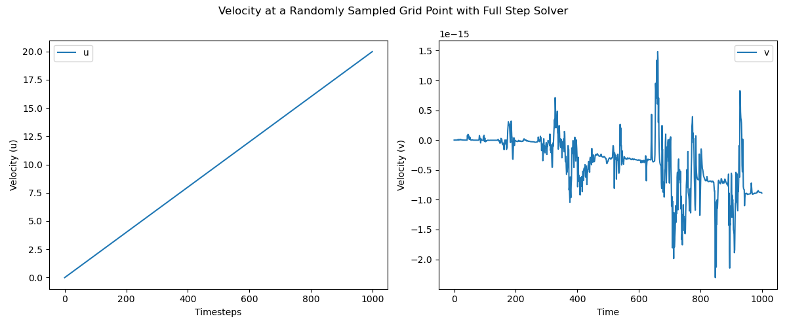
Constant Force (Full Step Solver)

Slide 18
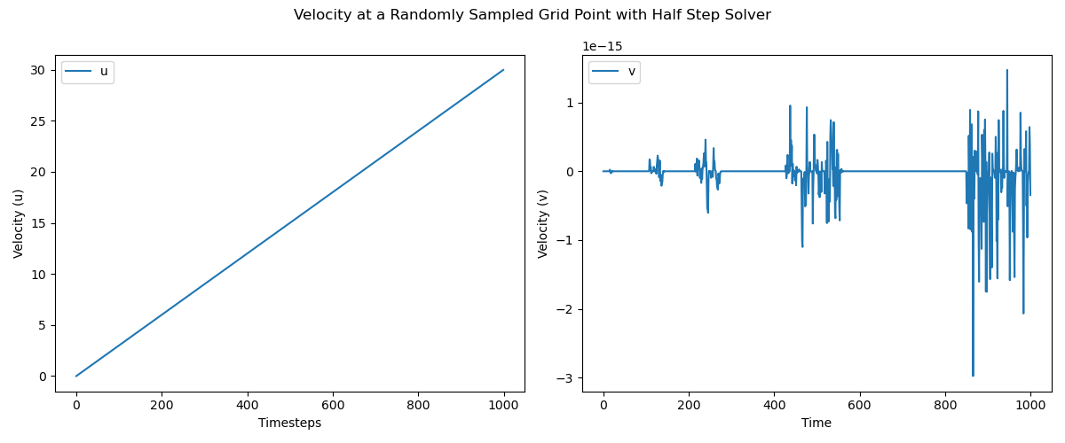
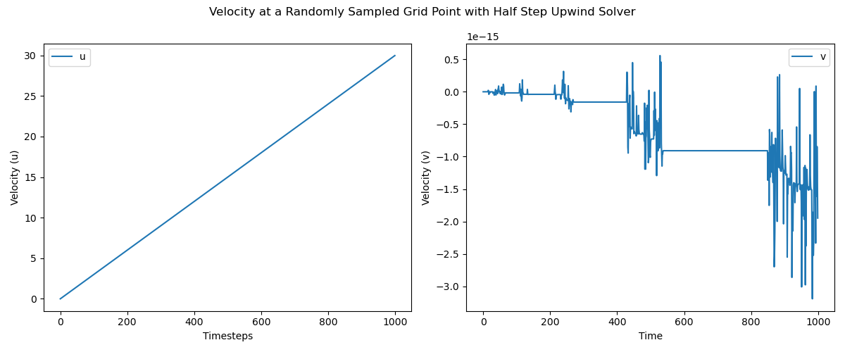
Constant Force (Half Step Solvers)

Slide 19
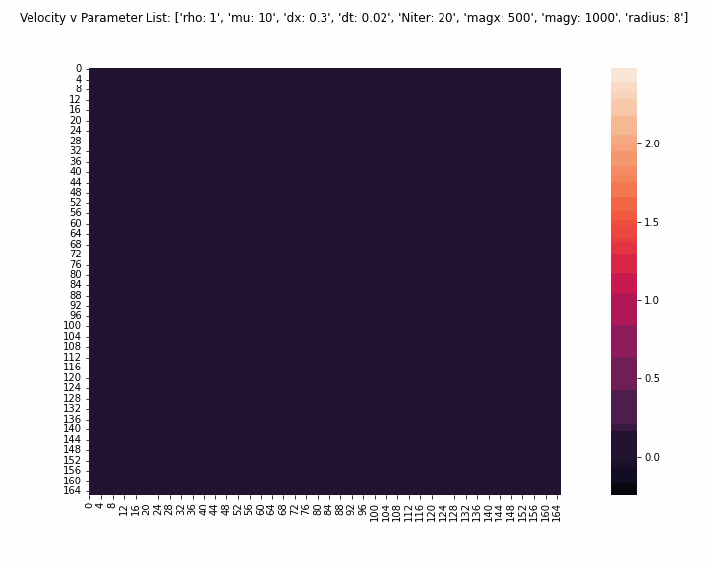
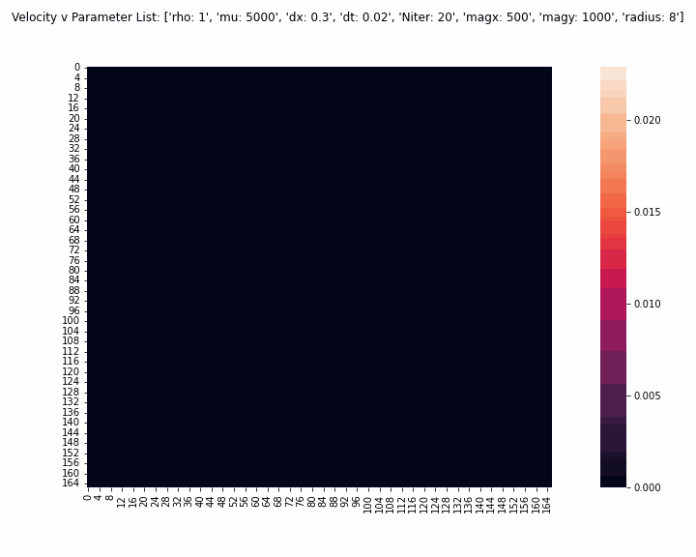
Explosion (Full Step Solver)
⍴ | 𝜇 | Results | Notes
1 | 10 | *y-component of the force density was larger than x-component **Explosion has rotational component to motion
1 | 100 | *The magnitude of the explosion is smaller, but the velocity spreads more

Slide 20
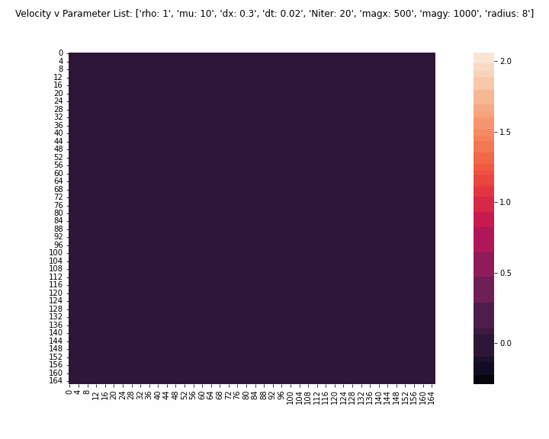
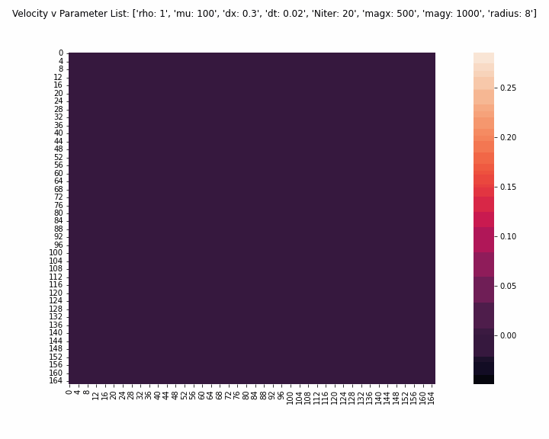
Explosion (Half Step Solver)
⍴ | 𝜇 | Results | Notes
1 | 10 | *y-component of the force density was larger than x-component **Explosion has rotational component to motion
1 | 100 | *The magnitude of the explosion is smaller, but the velocity spreads more Notable differences from full step solver

Slide 21
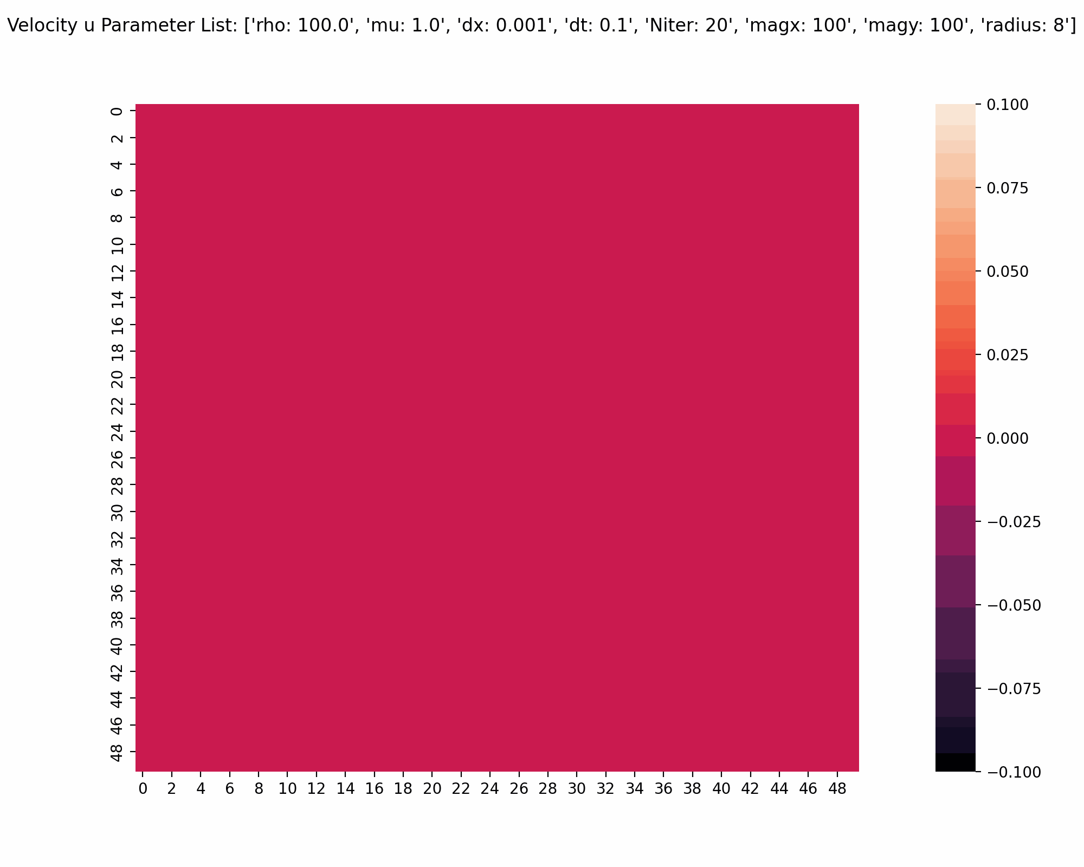
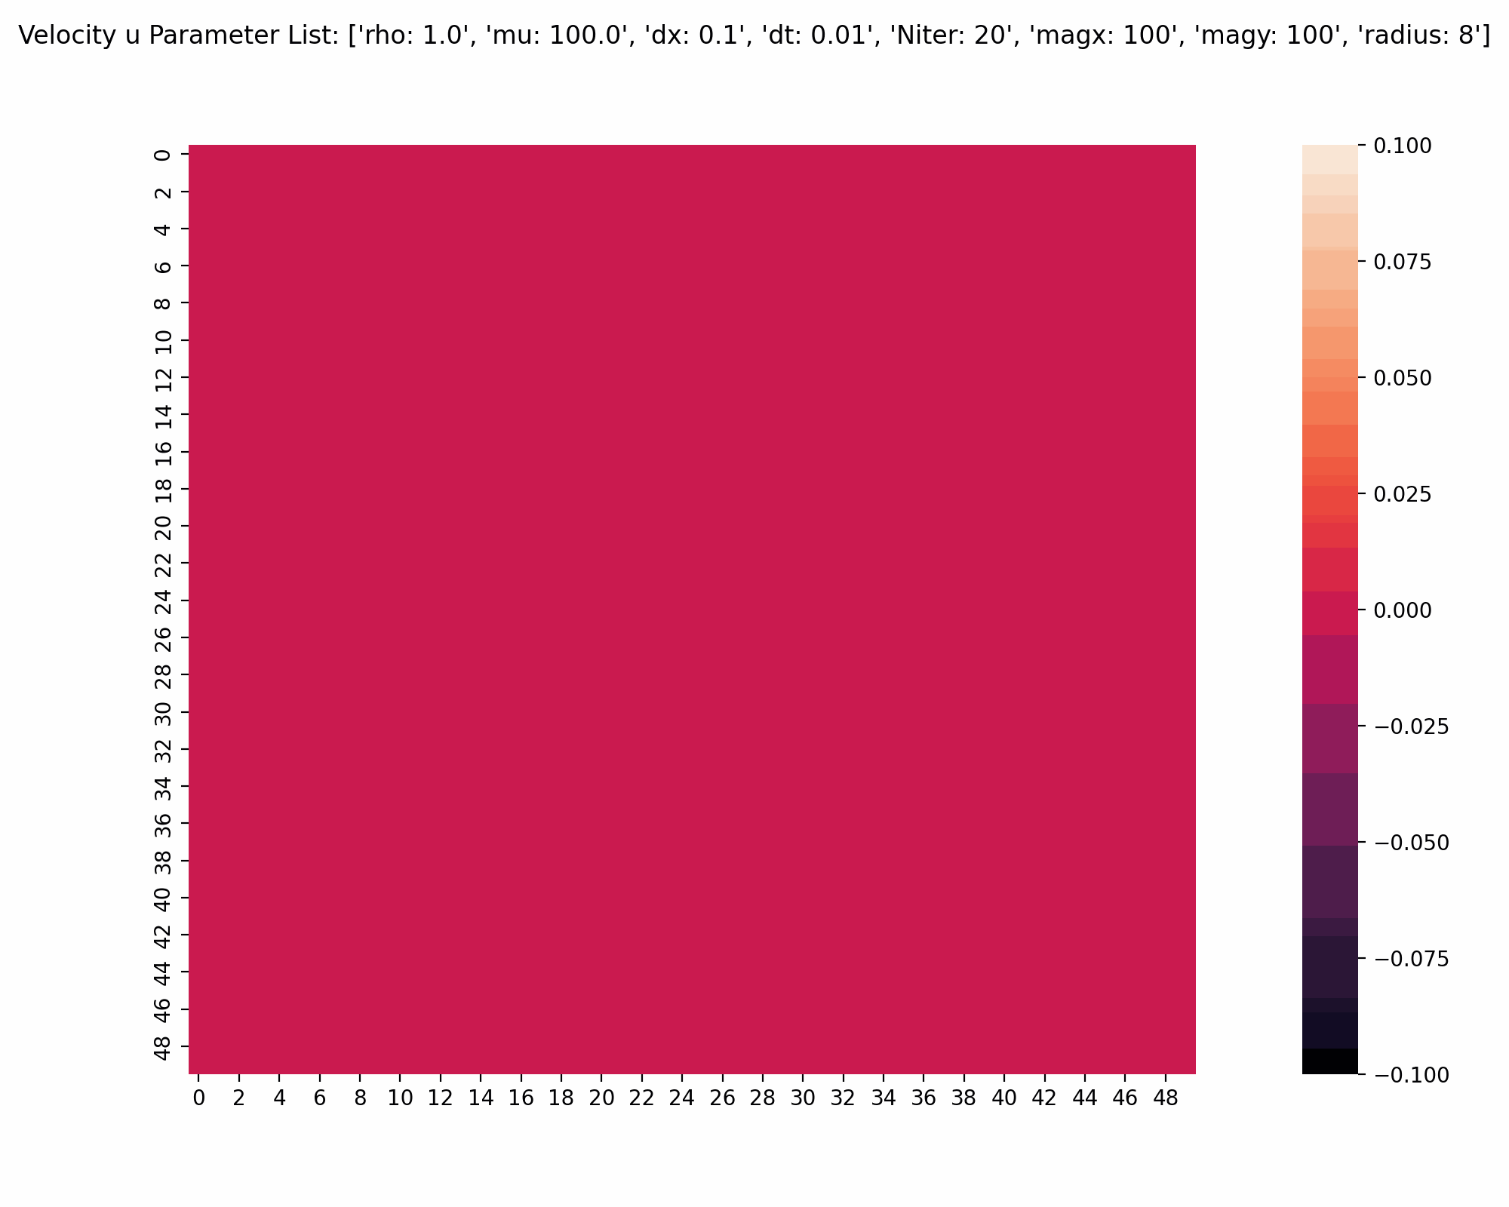
Instability
The stability of the solution depends on
the time step size
the grid size
The smaller the grid size, the smaller dt has to be.
Best way to avoid instability is
large grid dimension L
large dx
small dt

Slide 22
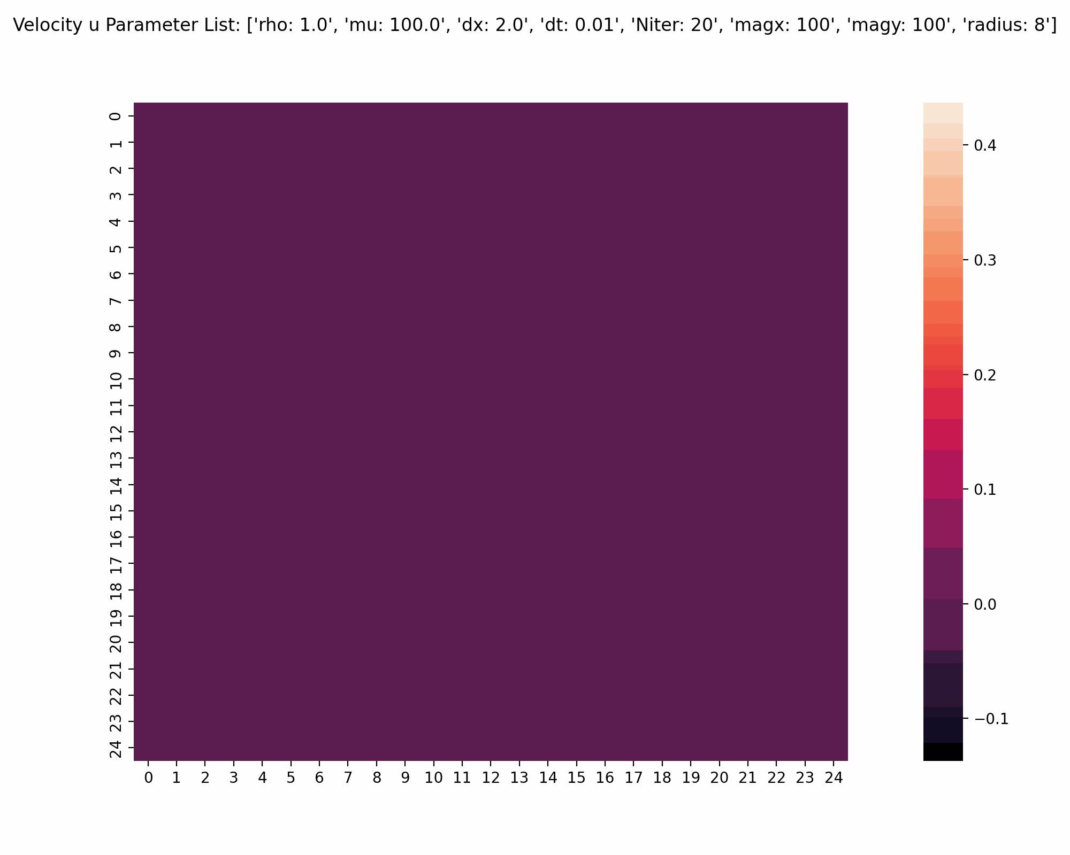

Slide 23


Slide 24
Large Eddy Simulation and
Reynolds-Averaged Navier-Stokes

Slide 25
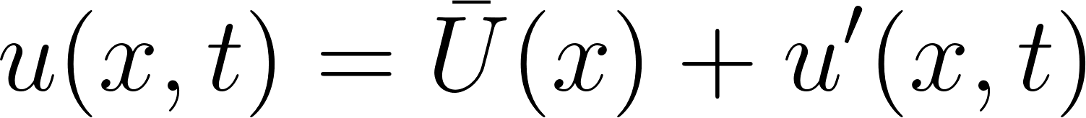
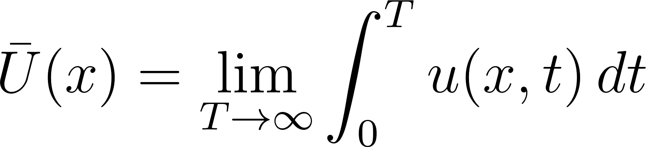
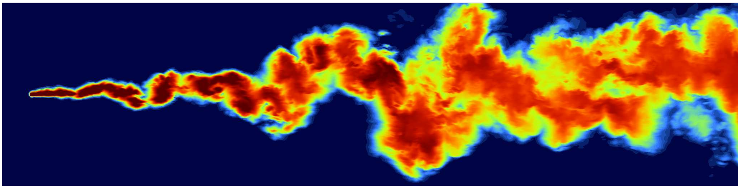
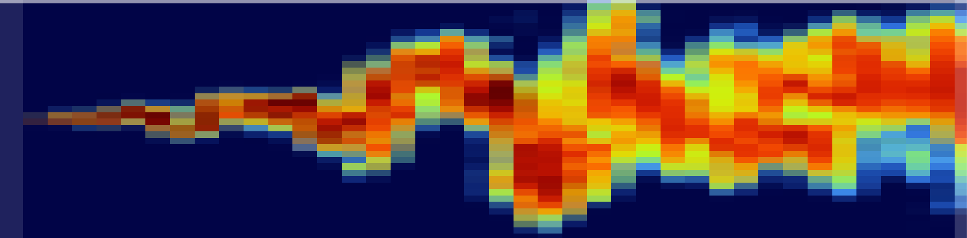
RANS vs LES
RANS:
LES:

Slide 26
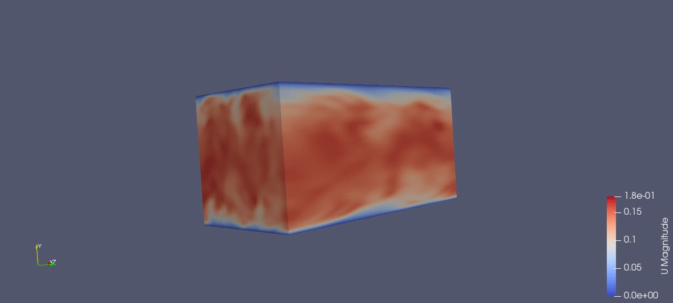
Our LES

Slide 27
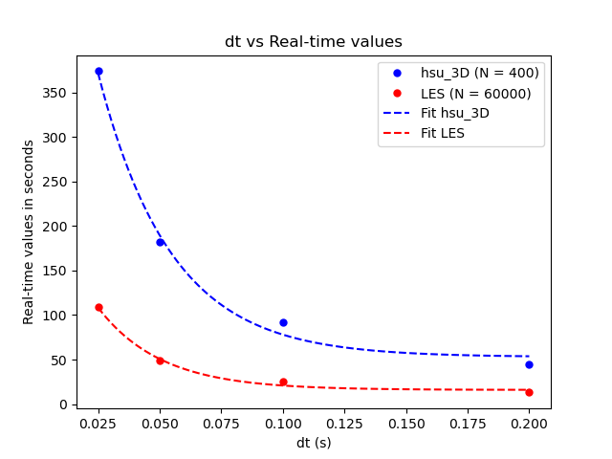
Comparing LES and DNS
DNS is theoretically more accurate, but computation takes more time.
LES takes less time to run and can handle large scale problems.
Notes:
Plot comparing half step upwind 3D solver and LES

Slide 28
Conclusions and Future Research
The half step solvers have a much smaller stability range than the full step solver, but they also have less error.
There is a subtle difference between upwind and central difference solvers.
Upwind solver will accumulate a slight directional error over time.
Effect is not noticeable if well inside stability range.
Stability range heavily dependent on grid size, but also on fluid parameters.
LES has more computational power than DNS.

Slide 29
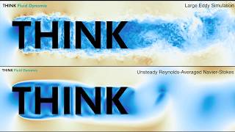

Slide 30
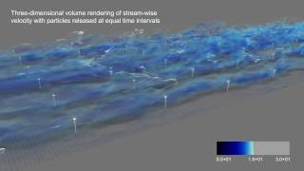

Slide 31
Bibliography
https://www.youtube.com/watch?v=qEtcCjln-0Q&ab_channel=PhysicsofFluidsGroupUniversityofTwente
https://www.simscale.com/docs/analysis-types/incompressible-fluid-flow-analysis/
https://en.wikibooks.org/wiki/Fluid_Mechanics/Incompressible_Flow
https://ntrs.nasa.gov/api/citations/20040084569/downloads/20040084569.pdf
https://pediaa.com/difference-between-compressible-and-incompressible-fluids/
https://www.ncbi.nlm.nih.gov/pmc/articles/PMC4117233/
https://royalsocietypublishing.org/doi/10.1098/rsbl.2016.0630

